Slide 1
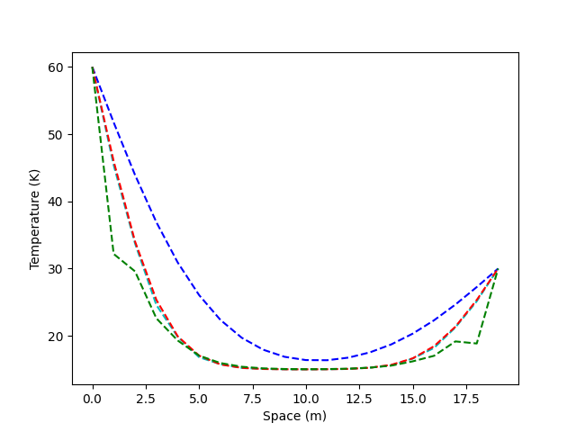
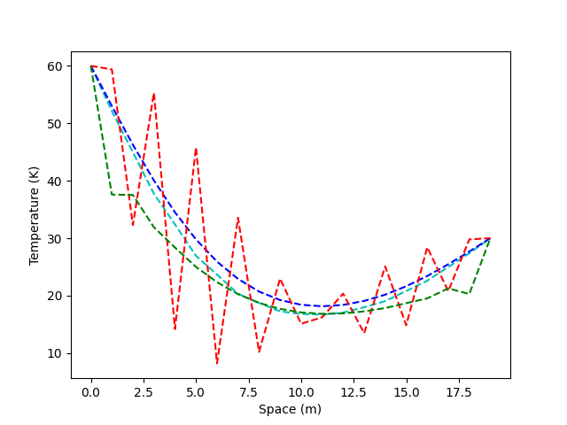
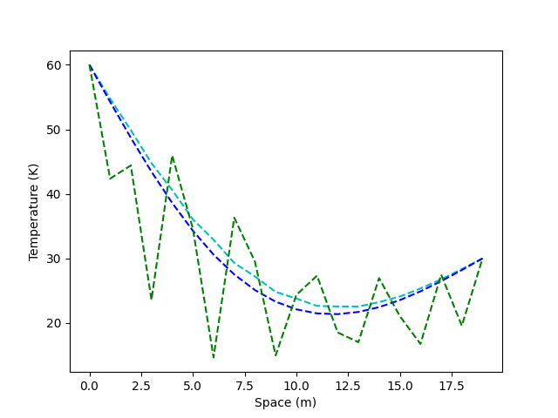
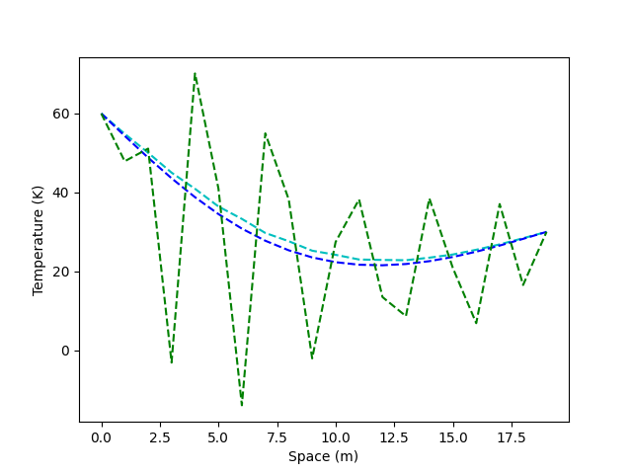
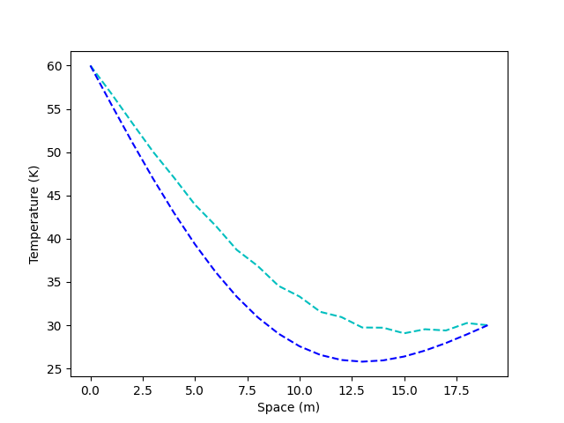
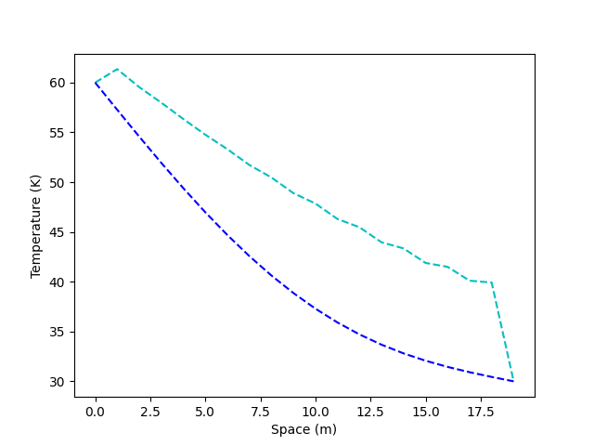
A
B
D
Red: FTCS
Blue: Crank-Nicolson
Green: Runge-Kutta
Cyan: DuFort-Frankel
Red: FTCS
Blue: Crank-Nicolson
Green: Runge-Kutta
Cyan: DuFort-Frankel
Red: FTCS
Blue: Crank-Nicolson
Green: Runge-Kutta
Cyan: DuFort-Frankel
E
F
G
Red: FTCS
Blue: Crank-Nicolson
Green: Runge-Kutta
Cyan: DuFort-Frankel
Red: FTCS
Blue: Crank-Nicolson
Green: Runge-Kutta
Cyan: DuFort-Frankel
Red: FTCS
Blue: Crank-Nicolson
Green: Runge-Kutta
Cyan: DuFort-Frankel

Slide 2
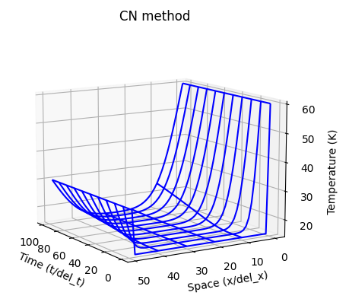
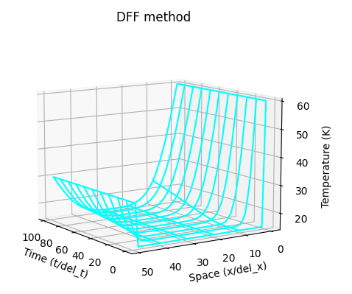
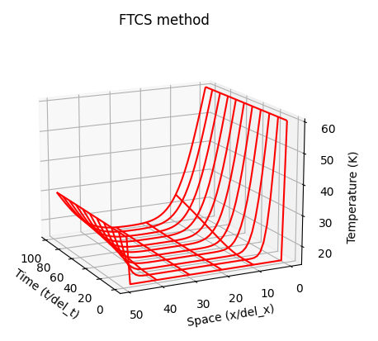
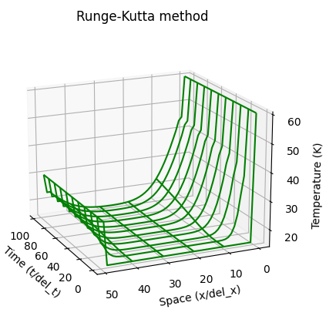

Slide 3
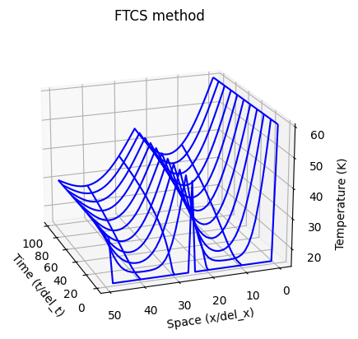
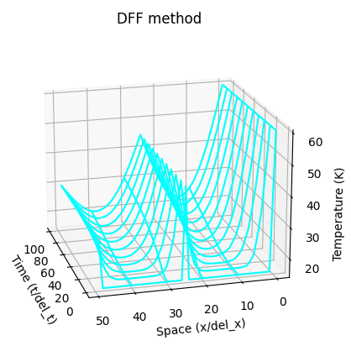
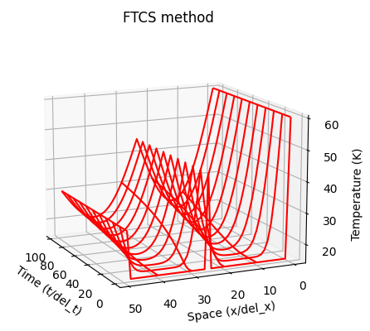
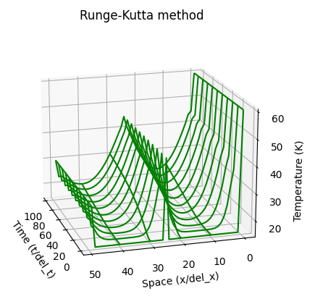

Slide 4
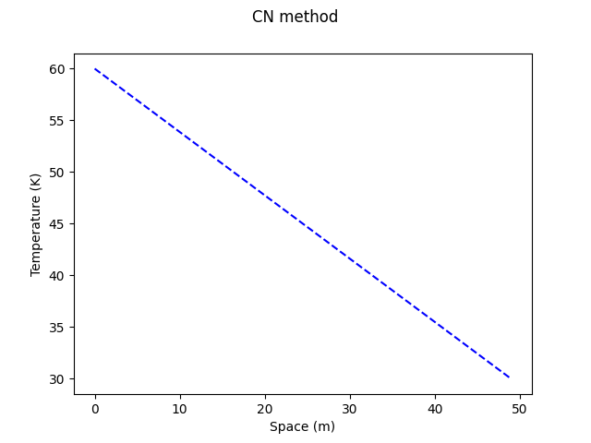
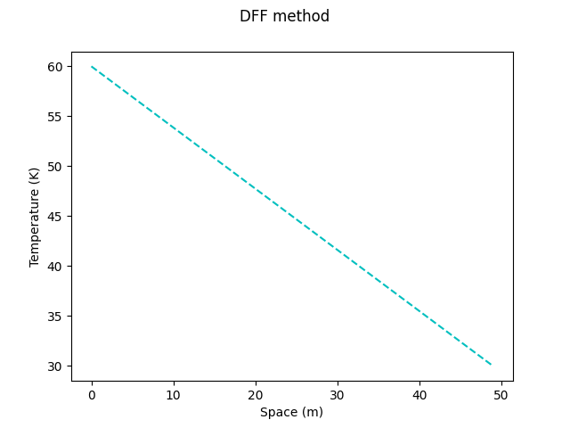
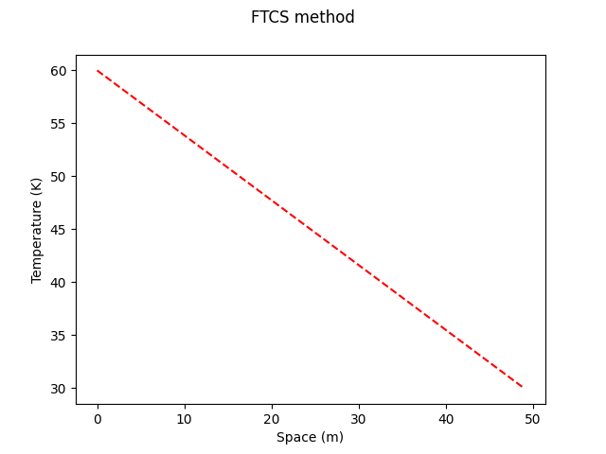
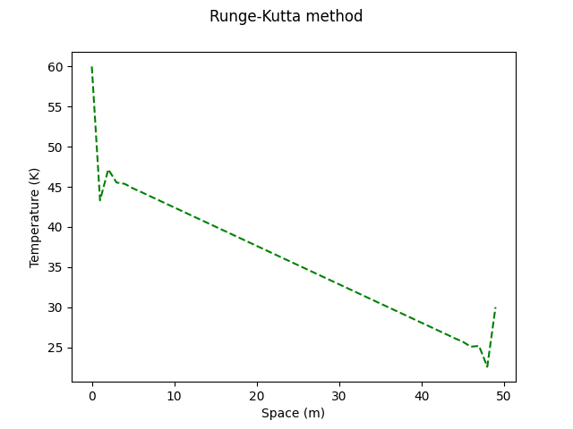

Slide 5
